Slide 1

Minimax is a two-pass search
1. assign heuristic values to the nodes
2. propagate the values up the tree.

Slide 2
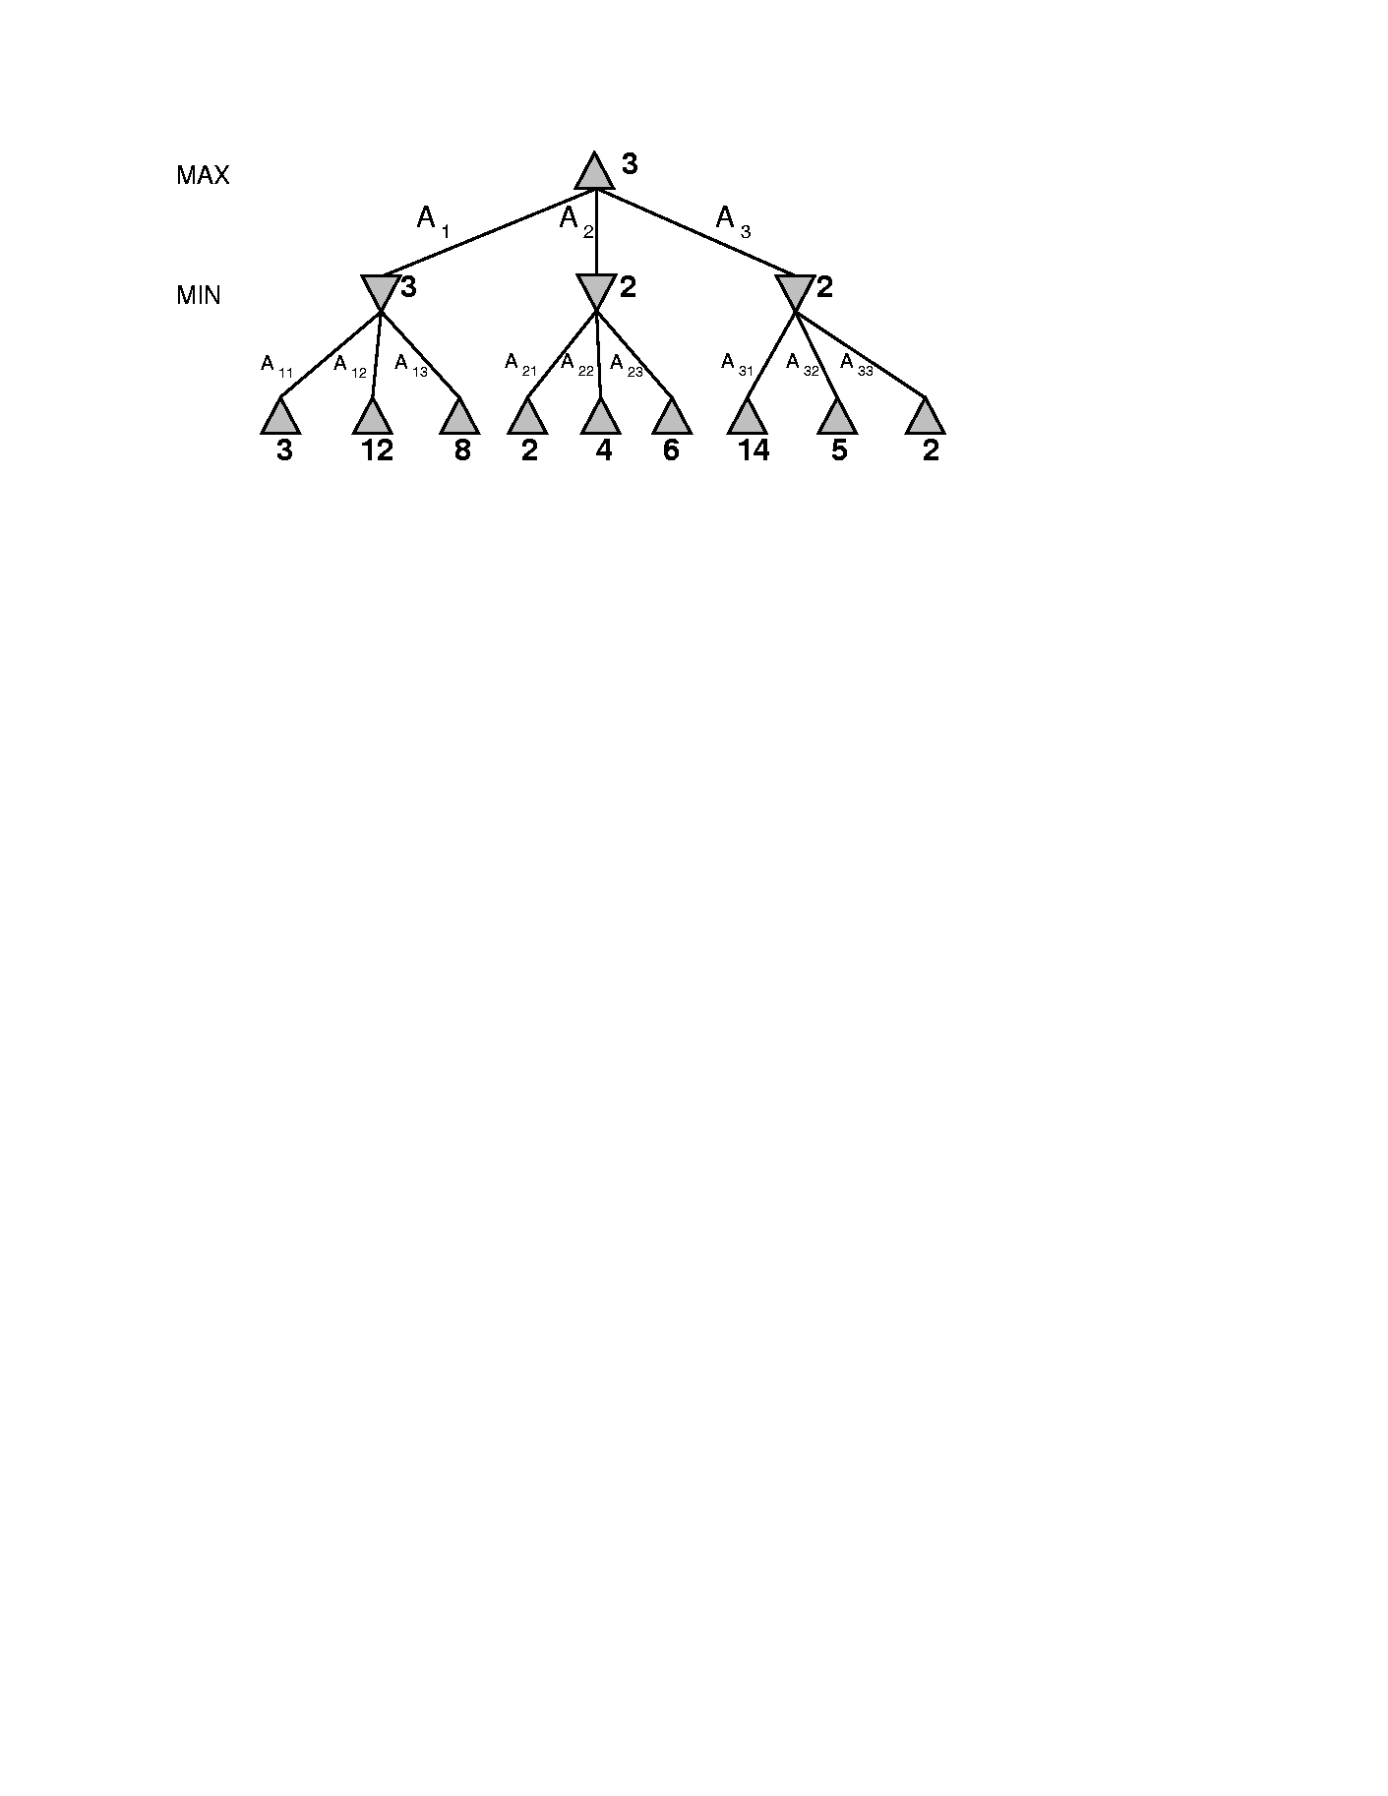
Minimax
computed
by minimax
MAX node
Max’s best move
MIN node
Min’s best move
computed
by function

Slide 3
Minimax Algorithm Illustrated
2
2
1
2
1
2
7
1
8
2
7
1
8
2
7
1
8
Move selected by minimax
2
Static evaluation
Value returned
2
1
MAX
MIN
2
7
1
8

Slide 4
Minimax Algorithm
function MINIMAX(N) is
begin
if N is a leaf then
return the estimated score of this leaf
else
Let N1, N2, .., Nm be the successors of N;
if N is a Min node then
return min{MINIMAX(N1), .., MINIMAX(Nm)}
else
return max{MINIMAX(N1), .., MINIMAX(Nm)}
end MINIMAX;

Slide 5
Minimax Procedure
Label each level of the search space according to whose move it is at that level.
Starting at the leaf nodes, label each leaf node with a 1 or 0 depending on whether it is a win for MAX (1) or MIN (0).
Propagate upwards: if the parent state is MAX, give it the MAX of its children.
Propagate upwards: if the parent state is MIN, give it the MIN of its children.

Slide 6
Properties of Minimax
Complete:
Optimal:
Time complexity:
Space complexity:
Yes, if tree is finite.
Yes, against optimal opponent. Otherwise??
O(b^{m}).
O(bm).
m is depth of the tree
Problem: Must look at every node in the tree anf number of game states it has to examine is exponential in the number of moves.
For chess, b ≈ 35, m ≈ 100 for a “reasonable game.”
  Which is infeasible
Solution: Alpha-beta-pruning

Slide 7
αβ Pruning
Minimax: Position evaluation takes place after search is complete- inefficient
Essential idea: stop searching down a branch of tree when you can determine that it is a dead end.

Slide 8
Alpha Beta Procedure
Depth first search of game tree, keeping track of:
  Alpha: Highest value seen so far on maximizing level
  Beta: Lowest value seen so far on minimizing level
Pruning
  When Maximizing,
    do not expand any more sibling nodes once a node has been seen whose evaluation is smaller than Alpha
  When Minimizing,
    do not expand any sibling nodes once a node has been seen whose evaluation is greater than Beta

Slide 9
An alpha value is an initial or temporary value associated with a MAX node. Because MAX nodes are given the maximum value among their children, an alpha value can never decrease; it can only go up.
A beta value is an initial or temporary value associated with a MIN node. Because MIN nodes are given the minimum value among their children, a beta value can never increase; it can only go down.

Slide 10
suppose a MAX node's alpha = 6. Then the search needn't consider any branches emanating from a MIN descendant that has a beta value that is less-than-or-equal to 6. So if you know that a MAX node has an alpha of 6, and you know that one of its MIN descendants has a beta that is less than or equal to 6, you needn't search any further below that MIN node. This is called alpha pruning.
no matter what happens below that MIN node, it cannot take on a value that is greater than 6. So its value cannot be propagated up to its MAX (alpha) parent.

Slide 11
Similarly, if a MIN node's beta value = 6, you needn't search any further below a descendant MAX that has acquired an alpha value of 6 or more. This is called beta pruning.
The reason again is that no matter what happens below that MAX node, it cannot take on a value that is less than 6. So its value cannot be propagated up to its MIN (beta) parent.

Slide 12
Rules for Alpha-beta Pruning
Alpha Pruning: Search can be stopped below any MIN node having a beta value less than or equal to the alpha value of any of its MAX ancestors.
Beta Pruning: Search can be stopped below any MAX node having a alpha value greater than or equal to the beta value of any of its MIN ancestors.

Slide 13
Alpha-Beta Pruning Example
>=3
  Max (3, Min(2,x,y) …) is always ≥ 3
A1
A2
A3
3
≤ 2
≤14
≤5
2
A11
A12
A13
A21
A22
A23
A31
A32
A33
3
12
8
2
14
5
2
  Min (2, Max(3,x,y) …) is always ≤ 2
We know this without knowing x and y

Slide 14
Alpha-Beta Pruning
Summary
Alpha = the value of the best choice we’ve found so far for MAX (highest)
Beta = the value of the best choice we’ve found so far for MIN (lowest)
When maximizing, cut off values lower than Alpha
When minimizing, cut off values greater than Beta
Animation: http://www.csm.astate.edu/~rossa/alphabeta/ab.html

Slide 15
Alpha-beta algorithm
function MAX-VALUE (state, game, alpha, beta)
;; alpha = best MAX so far; beta = best MIN
if CUTOFF-TEST (state) then return EVAL (state)
for each s in SUCCESSORS (state) do
alpha := MAX (alpha, MIN-VALUE (state, game,
alpha, beta))
if alpha >= beta then return beta
end
return alpha
function MIN-VALUE (state, game, alpha, beta)
if CUTOFF-TEST (state) then return EVAL (state)
for each s in SUCCESSORS (state) do
beta := MIN (beta, MAX-VALUE (s, game, alpha, beta))
if beta <= alpha then return alpha
end
return beta

Slide 16
Effectiveness of Alpha-Beta Search
Worst-Case
  branches are ordered so that no pruning takes place
  alpha-beta gives no improvement over exhaustive search
Best-Case
  each player’s best move is the left-most alternative (i.e., evaluated first)
  in practice, performance is closer to best rather than worst-case
In practice often get O(b(d/2)) rather than O(bd)
  this is the same as having a branching factor of sqrt(b),
    since (sqrt(b))d = b(d/2)
    i.e., we have effectively gone from b to square root of b
  e.g., in chess go from b ~ 35 to b ~ 6
    this permits much deeper search in the same amount of time
    makes computer chess competitive with humans!

Slide 17
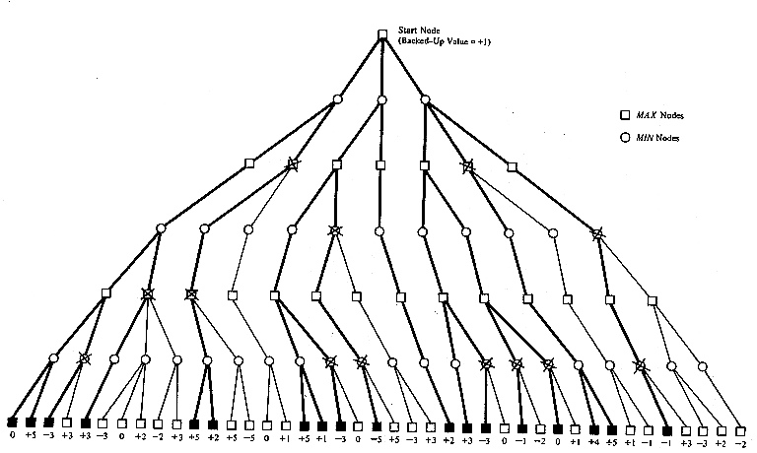
Alpha-Beta prunning in Tic-Tac-Toe

